Slide 1
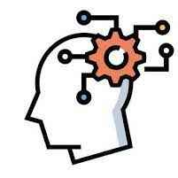
Critical Thinking in Undergraduates
Lightning Talk by Jutta M. Street
Campbell University
February 9, 2024

Slide 2
Critical Thinking
rational/logical
purposeful
goal directed
involves metacognition

Slide 3
Background
Observations
Diane Halpern’s Theory
Students’ critical thinking skills are generally weak
Often still quite dualistic
Critical thinking skills can be taught with exercises and applications

Slide 4
Method
This mixed-method study included the following steps:
(1) Thirty undergraduate students enrolled in a Developmental Psychology course received a 50-minute content unit about the developmental characteristics of the adolescent brain (social brain and prefrontal cortex).
(2) Students received a homework assignment that required them to
watch TED Talk by Sarah-Jayne Blakemore (2018) https://www.youtube.com/watch?v=yQXhFa8dRCI
and answer two prompts about legal issues that may affect adolescents.

Slide 5
Critical Thinking:
Adolescent Brain Unit
- lecture
- reading
- video
TASK:
Based on class lecture, your reading, and the information from the video, answer the following two questions in a comprehensive essay. Begin each answer with your position on the issue and then discuss your reasons for your position and the evidence that backs up your reasons.

Slide 6
Prompts
Prompt I:
Recent research findings about the teenage brain have found an interesting application in the legal system. Legislators and advocates are using the research to argue for changes in laws affecting teenagers. For instance, statistics have long shown that teenagers are much more prone to be involved in motor vehicle accidents. Pulling together the research on brain functioning with what we know about peer influence, some states have put limits on the number of passengers a teenage driver can have in a car. The reasoning? Due to brain immaturity, teens may be less able to deflect peer pressure to take risks when driving—and the more peers are present in the car, the greater the pressure.
Q1:
Based on what you have learned from your textbook, the class lecture, and the video about teenage brain development, do you think the highlighted argument is valid? Explain why or why not.

Slide 7
Prompts
Prompt II:
Another area in which this research on the adolescent brain is being used is with regard to decisions whether teenagers charged with serious crimes should be tried as adults. Decisions vary from case to case, but when teenagers are charged as adults in these serious situations, advocates ask, “Is this fair when teenagers still may have the minds of children?”
Q2:
Discuss whether or not you think teenagers charged with serious crimes (felonies) should be tried as adults. Explain why or why not.

Slide 8
Hypotheses
H1: There will be a significant difference between the scores for Prompt I and
Prompt II.
H2: The majority of response pairs will show inconsistant reasoning.

Slide 9
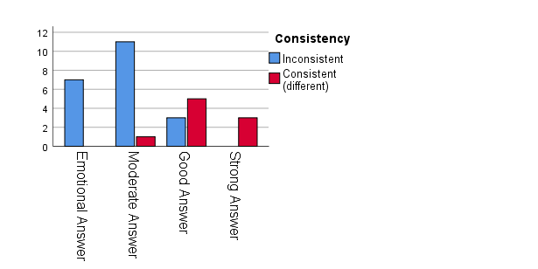
RESULTS
Paired t-test: significant difference between the scores for Response 1 (M = 3.77, SD = .728) and Response 2 (M = 3.23, SD = .935)., with t(29) = 3.247, p = 0.003.
Due to the small sample size, this analysis has only moderate power, with a mean difference of 0.51 and a 95% CI: .197 - .869.
Only 9 of 30 students (30%) exhibited logically consistent reasoning across prompts.

Slide 10
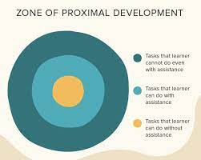
CONCLUSIONS
Adolescents demonstrate limited ability in critical/rational thinking.
With the more remote (less concrete) prompt reasoning becomes emotional, rather than rational.
Future research: apply Lev Vygotsky’s theory of cognitive development:
  Prompt I: comfort zone
  Prompt II: zone of proximal development (scaffolding)

Slide 11
References
Cerbin, W. (2018). Improving student learning from lectures. Scholarship of Teaching and Learning in Psychology, 4(3), 151–163. https://doi.org/10.1037/stl0000113
Halpern, D. F. (2003). Thought & knowledge: An introduction to critical thinking (4th ed.). Lawrence Erlbaum Associates Publishers.
Muehlenkamp, J. J., Weiss, N., & Hansen, M. (2015). Problem-based learning for introductory psychology: Preliminary supporting evidence. Scholarship of Teaching and Learning in Psychology, 1(2), 125–136.
Acknowledgements:
A heartfelt thank you to all of the students who participated in this research
Thank you to Campbell University for a Faculty Development Grant for Spring 2023

